Slide 1

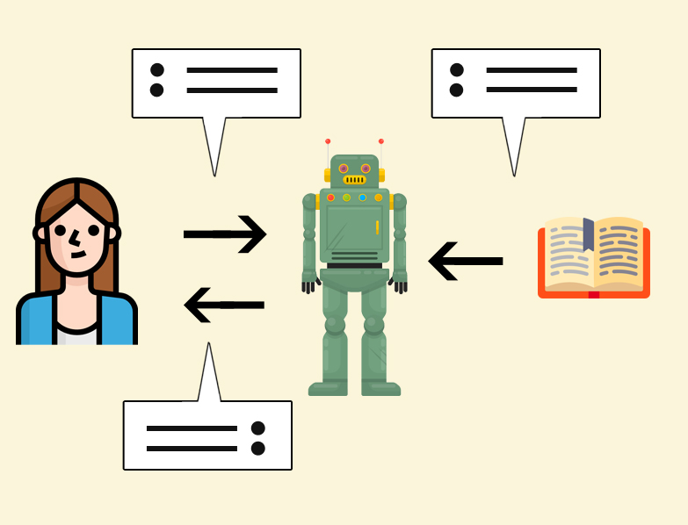
Text Generation AI
Next word Prediction
Building a neural network machine learning model that predicts the next word of a given text sequence. We also use this model, to generate text.

Slide 2
Procedure - Steps Involved
💡 Training a neural network to predict the next word can be useful for auto-completion and text generation tasks.
📊 Importing necessary libraries like TensorFlow, NumPy, and NLTK is crucial for building the text generation AI.
🧩 Tokenizing the text helps in preprocessing and organizing the data for model training.
🔬 Training the model with the provided dataset helps in learning the patterns and predicting the next word accurately.
⌨️ Predicting the next word can be done by providing input words and choosing the most likely prediction using the trained model.
📝 The generated text may not always make sense due to limitations in the training data and model complexity.
🤔 Further improvements can be made by training the model on larger datasets and fine-tuning the architecture.

Slide 3
References
Dataset: https://www.kaggle.com/datasets/ronikdedhia/next-word-prediction
GitHub :-
https://github.com/NeuralNine/youtube-tutorials/tree/main/Text%20Generation%20AI%20-%20Next%20Word%20Prediction
YouTube Tutorials :- https://youtu.be/tEV_Jtmx2cc?si=6_nKPXRGcxJhKqRM
My Git Hub repo :- https://github.com/SudhanvaMS2004/Next_word_prediction

